Slide 1

HealthCare Cost Analysis
Presented By-Soumya Ranjan Sethi
Guided By-Deepti Gupta

Slide 2
Introduction-
Healthcare Global Market Report 2018. The global healthcare market is expected to grow to $11801 billion in 2021 at an attractive compound annual growth rate
Healthcare industry is segmented into healthcare services, pharmaceuticals drugs, medical equipment and biologics.

Slide 3
Business Problem- Analyse the data to research on healthcare costs and their utilization.
Solution-To build the Multiple linear Regression model .

Slide 4
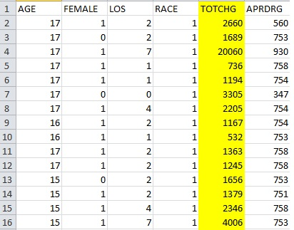
Data Analysis
Variables-
The Data have 500 Observations and 6 Variables.
Dependent Variable-”TOTCHG”
Independent Variables-”AGE”,
“FEMALE”, ”LOS”, ”APRDRG”.

Slide 5
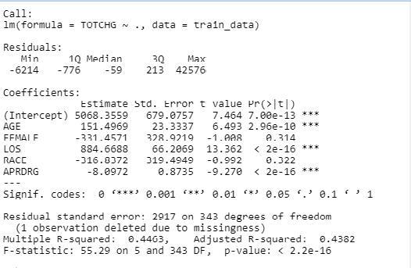
Model Building & Interpretation-
Model-1
Interpretation-
(1) These are the p-VALUE S <0.05 (SIGNIFICANT TO PROJECT):
“AGE”, “LOS”, “APRDRG”
(2) Slope of “AGE”, “LOS”, “APRDRG” is 151.49, 884.66, -8.0972
(3)So if 1 unit increase in “AGE” increase the hospital cost by 151.496 units.
If 1 unit increase in “LOS” increase the hospital cost 884.668 units.
If 1 unit increase in “APRDRG “, decrease the hospital cost 8.0972 units.

Slide 6
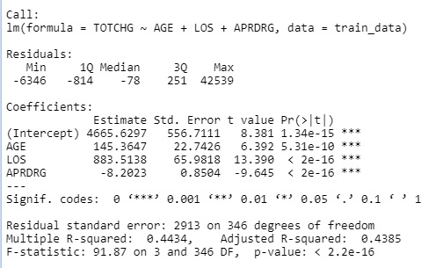
Re-Run the model using Significant
Model-2
Interpretation-
Slope of “AGE”, “LOS”, “APRDRG” is 145.36, 883.513 & -8.2023
Scientific relationship-
1 units increase in “AGE”, increase the hospital cost by 145.3647 units.
1 units increase in “LOS” increase the hospital cost by 883.51 units
1 units decrease in “APRDRG”
decrease the hospital cost by 8.2023
units.
Multiple R-squared-0.4434 &
Adjusted R-squared-0.4385

Slide 7
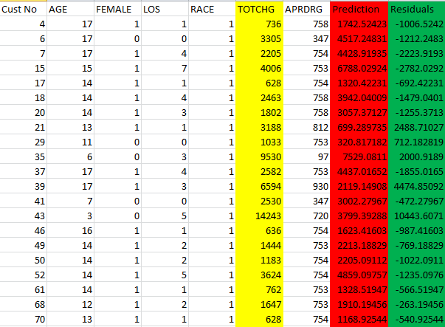
Output Values-

Slide 8

Conclusion-
As the Residuals are very high so the difference between Actual Cost and Prediction Cost is very high so the model is not good model, We need more Rich data.
The final R-squared is 0.4434 and the Adjusted R-squared is 0.4385

